Slide 1
Memory Management Module 5
Operating Systems
Nadia Qureshi

Slide 2
Chapter Outline
Memory
Memory hierarchy
Process loading and swapping
Memory management
Memory allocation methods
Storage management strategies
Contiguous memory allocation
Non-contiguous memory allocation
Paging
Simple paging
Implementation of paging
Segmentation
Simple segmentation
Segment addressing

Slide 3
Non-contiguous Memory Allocation
Paging & Segmentation

Slide 4
Paging
Fixed sized and variable sized partitions are insufficient due to
Internal fragmentation
External fragmentation
Paging removes these problems
Main memory is partitioned into equal fixed-size chunks called frames
Relatively small in size
Each process is also divided into fixed size chunks called pages
Same size as memory frames
Page size is typically power of 2 (typically 4K-8K)
depending on the computer architecture
No need of contiguous frames for a process or even in correct order

Slide 5
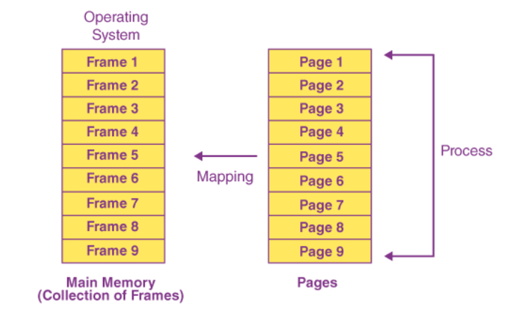
Paging

Slide 6
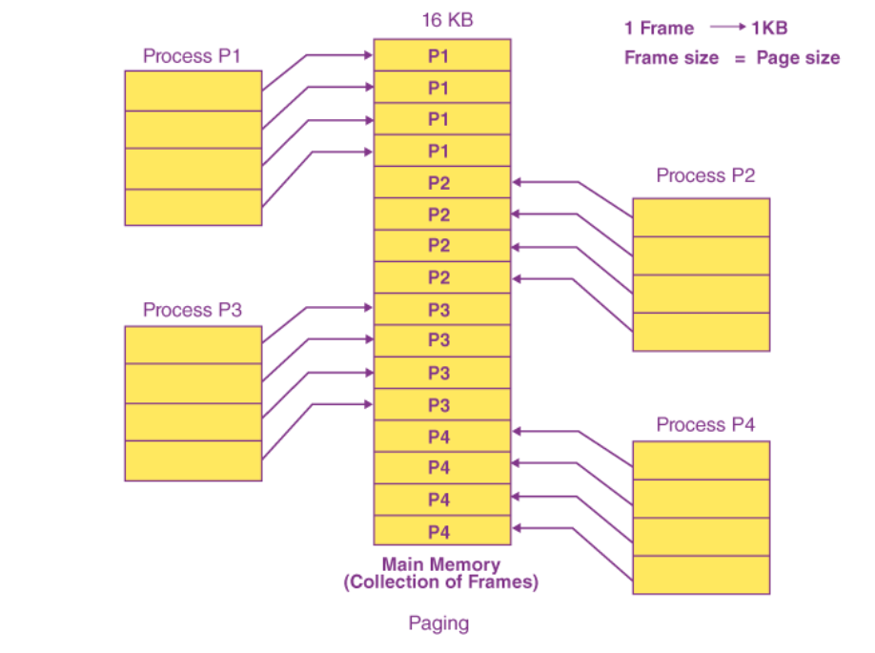
Paging Example Assuming that the main memory is 16 KB and the frame size is 1 KB, the main memory will be partitioned into a collection of 16 1 KB frames. P1, P2, P3, and P4 are the four processes in the system, each of which is 4 KB in size. Each process is separated into 1 KB pages, allowing one page to be saved in a single frame

Slide 7
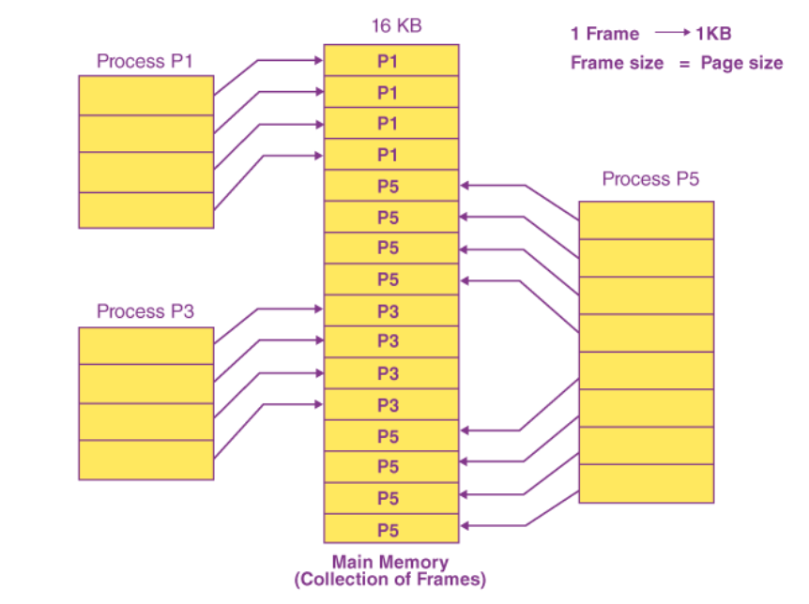

Slide 8
Paging
Page 1
Page 0
Page 2
Page 3
Process A
Page Table
Page 1
Page 0
Page 2
Page 3
12
13
14
15
16
17
18
19
20
21
12
13
14
15
16
17
18
19
20
21
Free frame list
14
13
18
20
15
0 | 14
1 | 13
2 | 18
3 | 20
Process A
Page 0
Page 1
Page 2
Page 3

Slide 9
Page Addressing
In paging, a memory address locations has the form (p,d)
Where p is number of the page
d is the displacement (or offset) of the location from the start of the page
These parameters are derived from the actual memory address
Consider an example of 16-bit address;
p - page no. has the value range 0 to 31 (2⁵-1) or 32 pages
d – displacement value range 0 – 2047 i.e. (2¹¹-1)
This system would have 32 pages each of 2048 locations
Example;
Page no Displacement
Binary 01101 00000101100
Decimal 13 44
Hence Page address is (13,44)
page number
page offset
p
d

Slide 10
Page Address Translation
Each process has its own page table
The page tables are held in memory
The page table register contains memory address of the page table for the active process
A context switching also saves the value of page table register
The address translation and page table maintenance are implemented in hardware called memory management unit (MMU) to achieve maximum speed of translation
Each page table entry contains the real memory page translation and number of control bits
E.g.
The present or p bit indicates whether corresponding page is in main memory or not
The modified or M bit indicate whether or not the page has been modified
A modified page is called dirty page

Slide 11
Page Address Translation
When a page is positioned in a frame, the page number parameter of the address changes but the displacement remains constant
The Intel Pentium can use 32 bit addressing space providing 4 gigabytes of addressable space

Slide 12
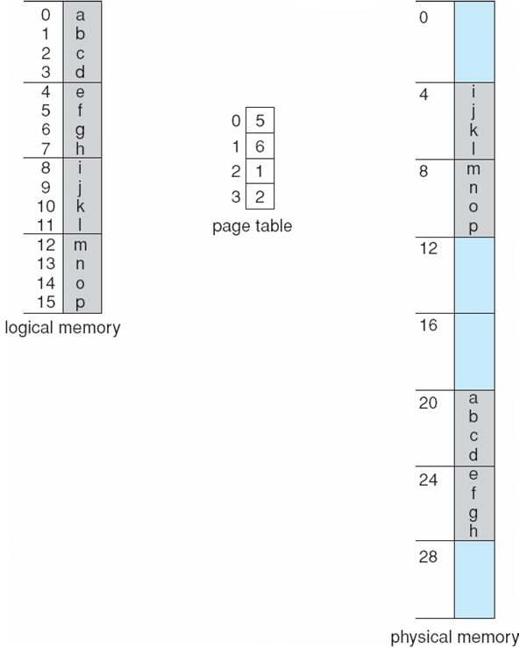
Page Address Translation
For example frame size is 4 bytes. Translate the logical address 11 into physical address.
Frame No. * Frame Size + Offset

Slide 13
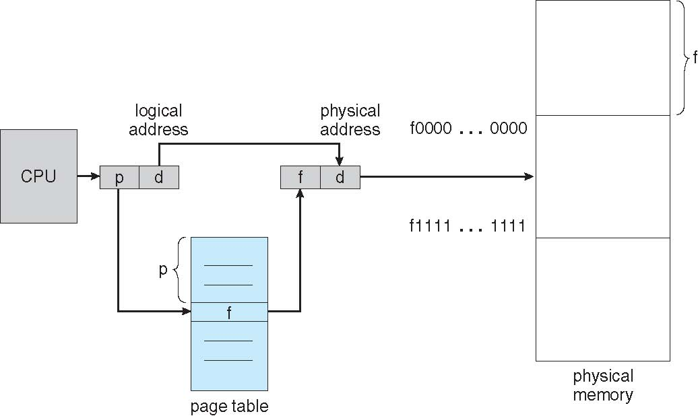
Page Address Translation

Slide 14
Page Address Translation
Page No
Displacement
Frame No
Displacement
Virtual address
Real memory address
Page table
0
1
2
3
4
5
6
Frame no.

Slide 15
Page Address Translation
p d
0101
010110011011
1110
010110011011
Memory address
Converted memory address
Page table
0
1
2
3
4
5
6
0111
1001
0001
1011
0000
1110
0110

